Slide 1
Chapter 27
Population Patterns &
History and Governments

Slide 2
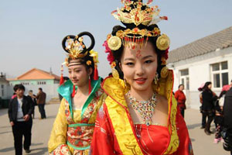
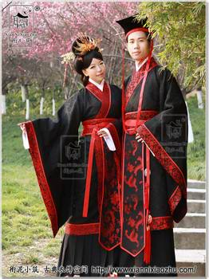
Population Patterns
Human Characteristics
  1.5 billion people
    25 % of world population
    Major ethnic groups
      Chinese, Tibetan, Korean, Japanese, and Mongolian
China
  “people of the middle kingdom”
  Major ethnic group: Han
    Major dynasty in power from 206 B.C. to A.D. 220
  Other ethnic groups (8%)
    Belong to 55 different groups
      Most live in Western and Northern China
        Ex. Tibetans – ruled by Chinese since 1950

Slide 3
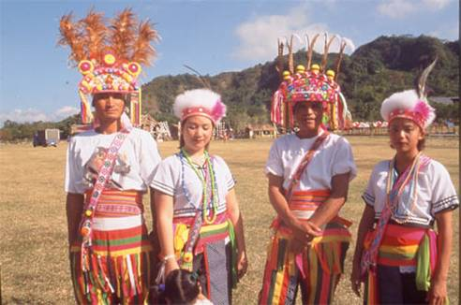
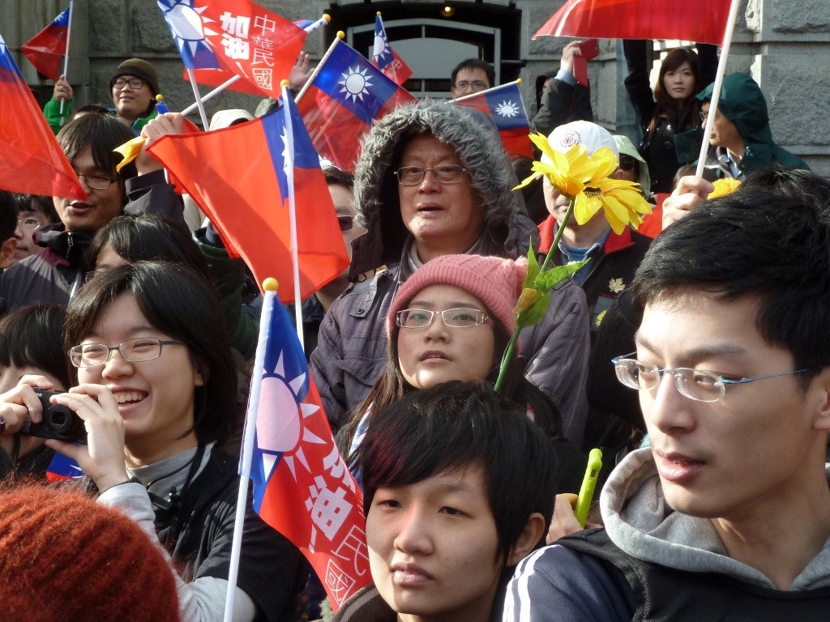
Population Patterns (cont.)
Taiwan
  Most Taiwanese descended from Chinese who came hundreds of years ago
  15% came after Communist takeover of China
  Taiwan’s original inhabitants
    ABORIGINES
      Related to people of Southeast Asia
      2% of Taiwan’s population

Slide 4
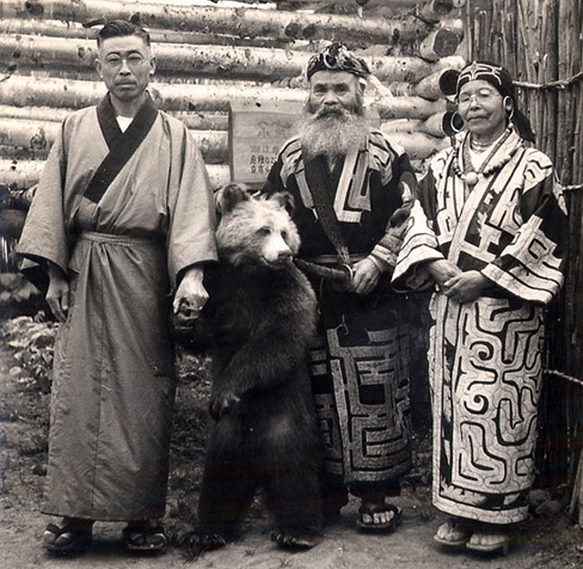
Population Patterns (cont.)
Japan, Korea, & Mongolia
  Japan
    Ethnically HOMOGENOUS
      99% Japanese
      Crossed from Korean peninsula centuries ago
    Native inhabitants: AINU
      Forced to Northern island: Hokkaido
  Korea
    Also ethnically homogenous
    Trace origins to early peoples from Northern China and Central Asia
  Mongolia
    Mostly ethnic Mongolians
    Once ruled largest land empire in history
    Divided into different linguistic groups
      90% speak KHALKHA Mongolian language

Slide 5
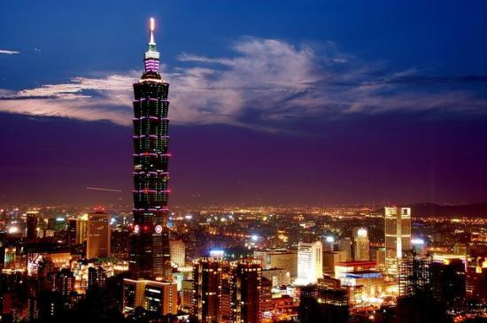
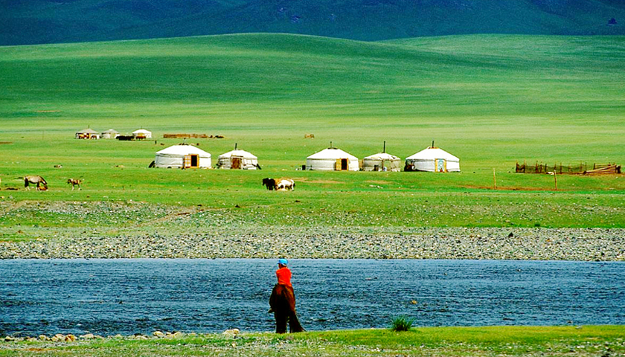
Population Patterns (cont.)
Where East Asians Live
  Most barren and mountainous
  Population distributed unevenly
  Most East Asians settle in coastal or fertile river areas
    Some of these most densely populated on Earth
China
  90% live on 1/6 of land
    Fertile valleys of great rivers and plains
    Major cities located in these areas
      6-13.5 million each
  Rugged Western provinces
    Xinjiang
      Farmers and herders – sparsely populated
    Inner Mongolia
      2.5 million
  Taiwan
    22.6 million
    Space limited
    Live in cities like TAIPEI or close to coast

Slide 6
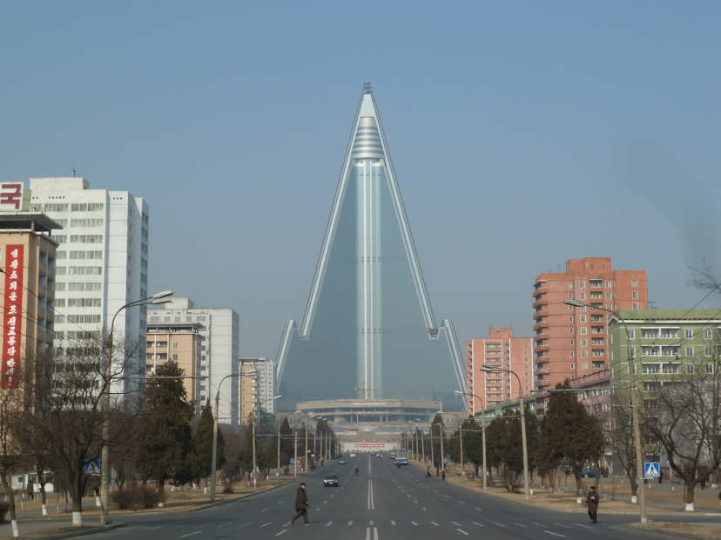
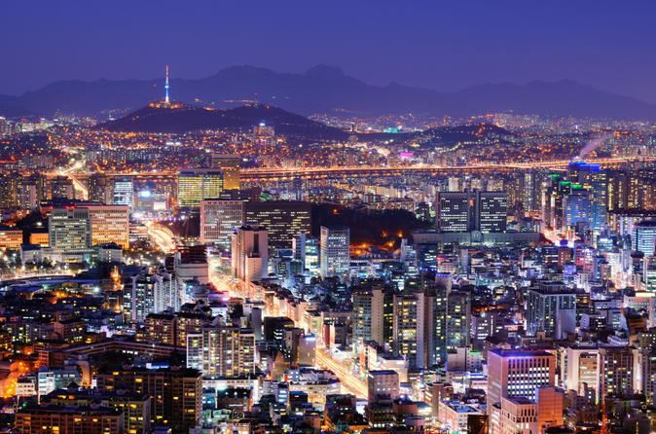
Population Patterns (cont.)
North & South Korea
  Most live in coastal plains that wrap around Peninsula
  2/3 live in growing cities like SEOUL and PYONGYANG
Japan
  Limited area for large population
  Mountains in center
    Only valleys and coastal plains good for settlement
    78% of 125 million people- urban coastal areas
      TOKYO CORRIDOR
        Series of cities crowded together on main island of HONSHU
        TOKYO – world’s most populous urban area

Slide 7
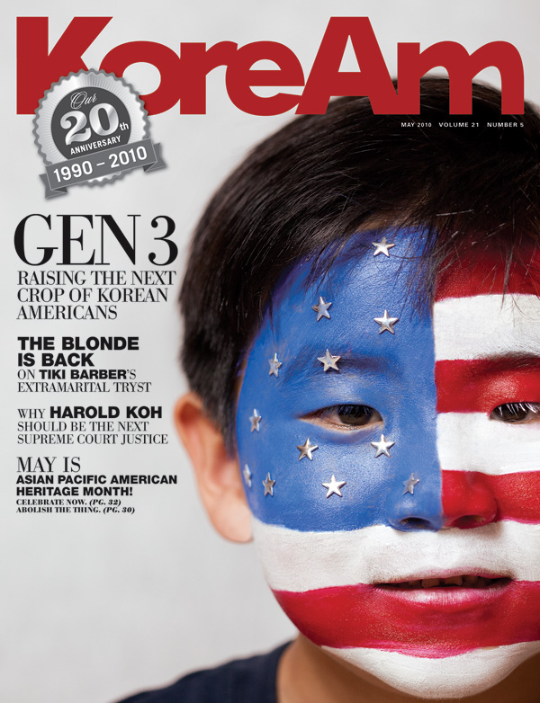
Population Patterns (cont.)
Japan’s Urban Lifestyle
  Neon signs, skyscrapers, people living in apartments
  Efficient transportation system: bullet train
    11 hr. trip by car takes 5 hours
Migration
  China
    Most Chinese still live and work on farms
      Chinese controlled Hong-Kong
        Attracts immigrants
          Special privileges
  South Korea
    People fled North Korea mid-1900s
      South Korea has twice as many people as North Korea

Slide 8
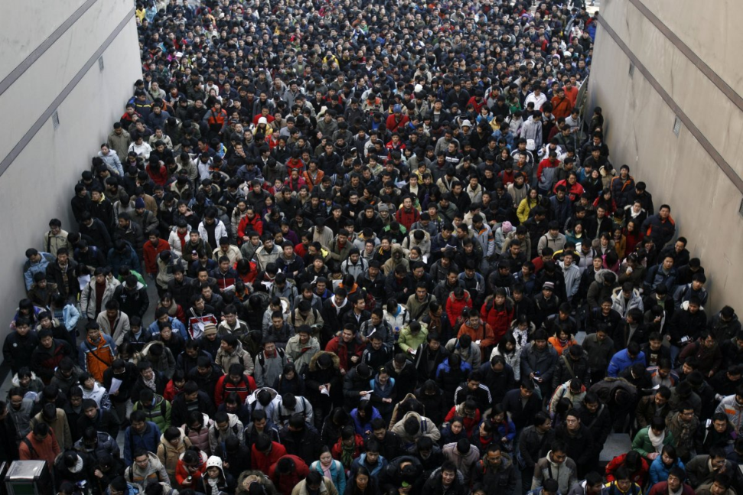
Population Patterns (cont.)
Challenges to Growth
  Urbanization has led to overcrowding in cities
    Chinese solutions: build rural agricultural towns in remote areas
      Designed to provide more social services/better quality of life
  Unchecked population growth
    1979: one-child policy begins (recently ended)

Slide 9
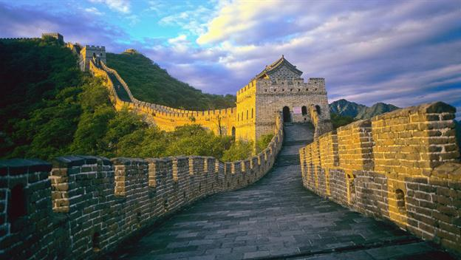
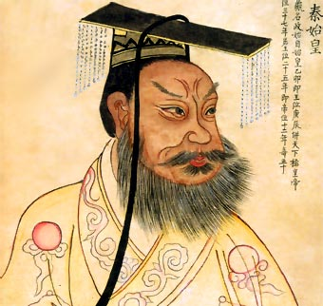
History and Government
City of Xi’an
  Life-size terracotta army
    Meant to protect Emperor Qin Shi Huang Di in the afterlife
      He also built GREAT WALL OF CHINA
    Tell us much about East Asian past
Ancient East Asia
  Home to some of the world’s oldest civilizations
  China was CULTURAL HEARTH for neighbors
    A center from which ideas and practices helped shape East Asia’s cultures

Slide 10
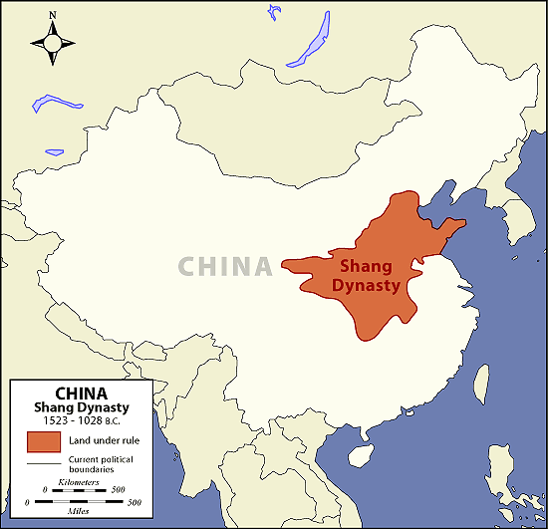
History and Governments (cont.)
China’s Dynasties
  Chinese culture started 5,000 years ago in Wei Valley (Yellow River area)
  Records first kept under Shang DYNASTY, or ruling family
    Took power 1600 B. C. in North China Plain
    Goals of Shang and later dynasties
      Put down rebellions
      Prevent incursions of Central Asian nomads
      Fix China following natural disasters
  When dynasty fell it had lost the “mandate of heaven”
    i. e. - “God” wanted this

Slide 11
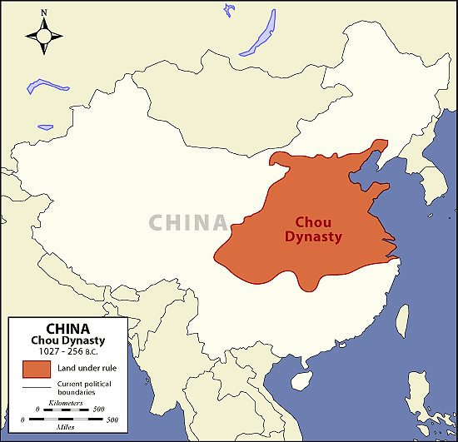
History and Governments (cont.)
Zhou Dynasty
  1122 B.C.
  Ruled for 900 years
  Contributions
    Culture and trade spread
    Development of iron tools
    Life of CONFUCIUS
      Chinese philosopher
        System of thought based on discipline and moral conduct
        Highly influential even today
    Life of LAOZI
      Founder of DAOISM
        Philosophy of simplicity and harmony with nature

Slide 12
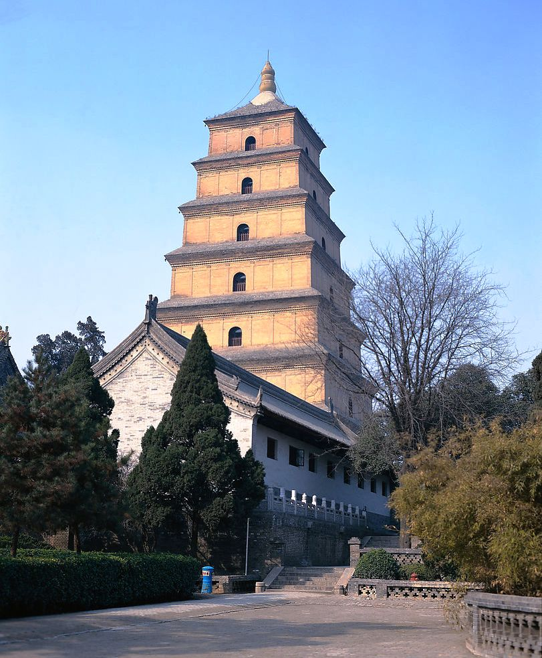
History and Governments (cont.)
200s B.C.
  Qin Shi Huang Di unites China
    Builds first section of Great Wall
Later dynasties
  Han, Tang
    Chinese culture spreads to all of E. Asia
  Ming
    Zheng He sails to E. Africa
  Qing
    Mid-1600s to early 1900s

Slide 13
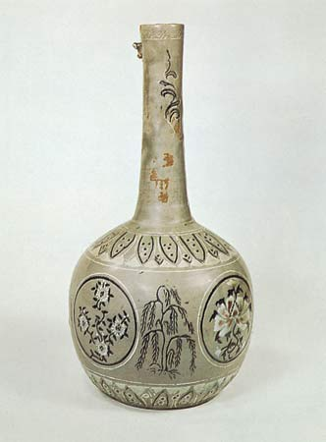
History and Governments (cont.)
Korea
  1200 B. C.
    Chinese settlers bring culture to Koreans
      Buddhism spread a bit later and becomes major Korean religion
  Later centuries
    Silla and Koryo dynasties unite Peninsula
    A.D. 1300
      China takes Korea
        Confucianism spread – becomes model for Korean government, education, and family life

